Slide 1
Intro to Arduino and different types of Arduino boards
CSE 315
Peripherals & Interfacing

Slide 2
What is Arduino
Arduino board is an open-source platform used to make electronics projects.
It consists of both a microcontroller and a part of the software or Integrated Development Environment (IDE) that runs on your PC.
It is used to write & upload computer code to the physical board.
The platform of an Arduino has become very famous with designers or students just starting out with electronics, and for an excellent cause.

Slide 3
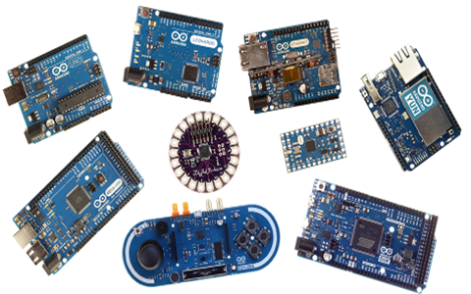
Different types of Arduino Boards
Fig 1. Different types of Arduino Boards.

Slide 4
Basic Features:
The Arduino does not require a separate part of hardware.
In order to program a new code onto the board you can just use a USB cable.
The Arduino IDE uses a basic version of C++, making it simpler to learn the program.
At last, Arduino board offers a typical form factor that breaks out the functions of the microcontroller into a more available package.

Slide 5
Why Arduino:
Arduino board has been used for making different engineering projects and different applications.
The Arduino software is very simple to use for beginners, yet flexible adequate for advanced users.
It runs on windows, Linux and Mac.
Teachers and students in the schools utilize it to design low cost scientific instruments to verify the principles of physics and chemistry.
Arduino also makes simpler the working process of microcontroller.

Slide 6
In a Nutshell:
Inexpensive
Cross-platform
Simple, clear programming environment
Open source and extensible software
Open source and extensible hardware

Slide 7
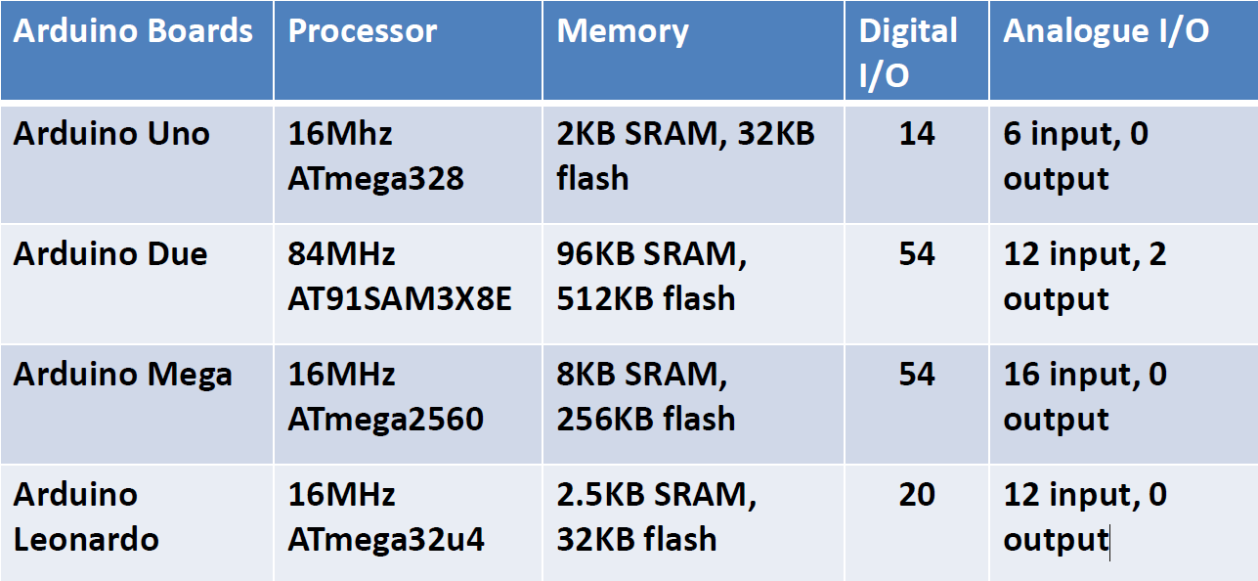
Feature analogy of different boards:

Slide 8
List of Arduino boards
Arduino Uno (R3)
LilyPad Arduino
Red Board
Arduino Mega (R3)
Arduino Leonardo

Slide 9
Arduino Uno R3
The Uno is a huge option for your initial Arduino.
It consists of 14-digital I/O pins, where 6-pins can be used as PWM(pulse width modulation outputs).
6-analog inputs, a reset button, a power jack, a USB connection and more.
It includes everything required to hold up the microcontroller.
Simply attach it to a PC with the help of a USB cable and give the supply to get started with a AC-to-DC adapter or battery.

Slide 10
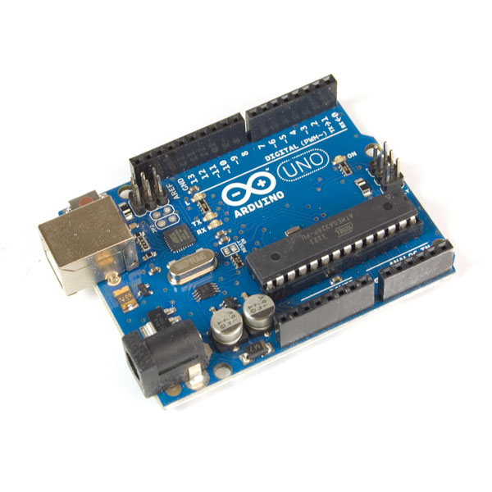
Arduino Uno(R3)
Fig 2. Arduino Uno basic hardware

Slide 11
Some projects based on Arduino UNO:
Automatic Medicine Reminder Using Arduino
Obstacle Avoiding Robot using Arduino and Ultrasonic Sensor
Google Assistant Based Voice Controlled Home Automation using DIY Arduino Wi-Fi Shield
Self balancing robot
Line follower

Slide 12
Arduino Lilypad
The Lily Pad Arduino board is a wearable e-textile technology .
It expanded by Leah Buechley and considerately designed by “Leah and SparkFun”.
Each board was imaginatively designed with huge connecting pads
A smooth back to let them to be sewn into clothing using conductive thread.
This Arduino also comprises of I/O, power, and also sensor boards which are built especially for e-textiles. These are even washable

Slide 13
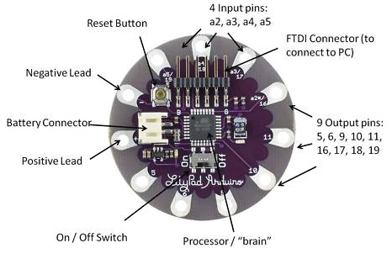
Arduino Lilypad
Fig 3. Arduino Lilypad basic hardware

Slide 14


Some projects based on Arduino Lilypad:

Slide 15
Some projects based on Arduino Lilypad:
Unicorn Horn With NeoPixel LEDs and Arduino Lilypad
Arduino LilyPad Controlled NeoPixel Earrings
Hertzian Armor

Slide 16
Arduino Redboard
The RedBoard Arduino board can be programmed using a Mini-B USB cable using the Arduino IDE.
It will work on Windows 8 without having to modify your security settings.
It is more constant due to the USB or FTDI (Future Technology Device International) chip we used and also it is entirely flat on the back.
Creating it is very simple to utilize in the project design.
Just plug the board, select the menu option to choose an Arduino Redboard and you are ready to upload the program.
You can control the RedBoard over USB cable using the barrel jack.

Slide 17
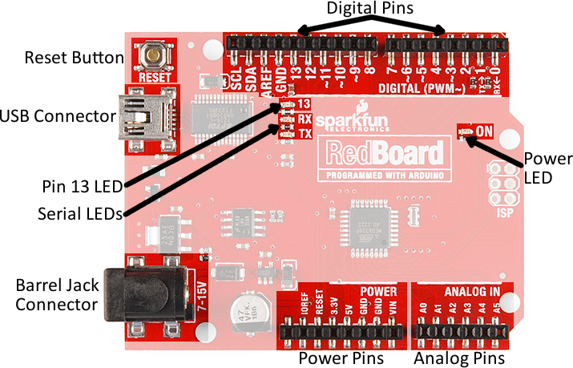
Arduino Redboard
Fig 4. Arduino Redboard basic hardware

Slide 18
Some projects based on Arduino Redboard:
DC MOTORS AND MOTOR DRIVERS
Autonomous Driving Vehicle

Slide 19
Arduino Mega (R3)
The Arduino Mega is similar to the UNO’s big brother.
It includes lots of digital I/O pins (from that, 14-pins can be used as PWM o/ps).
It includes 6-analog inputs, a reset button, a power jack, a USB connection and a reset button.
It includes everything required to hold up the microcontroller.

Slide 20
Arduino Mega (R3)
Simply attach it to a PC with the help of a USB cable.
Give the supply to get started with a AC-to-DC adapter or battery.
The huge number of pins make this Arduino board very helpful for designing the projects .
It need a bunch of digital i/ps or o/ps like lots buttons.

Slide 21
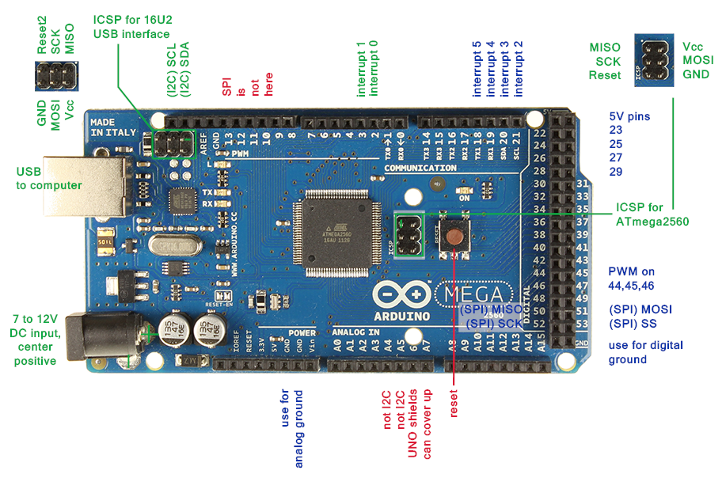
Arduino Mega (R3)
Fig 5. Arduino Mega (R3) basic hardware

Slide 22
Some projects based on Arduino Mega:
Arduino Serial Communication
Arduino Solar Tracker
Arduino RFID Reader
Frequency Counter Using Arduino

Slide 23
Arduino Leonardo:
The first developed board of an Arduino series is the Leonardo board.
This board uses one microcontroller along with the USB.
It can be very simple and cheap also.
This board handles USB directly.
The program libraries are obtainable which let the Arduino board to follow a keyboard of the computer, mouse, etc.

Slide 24
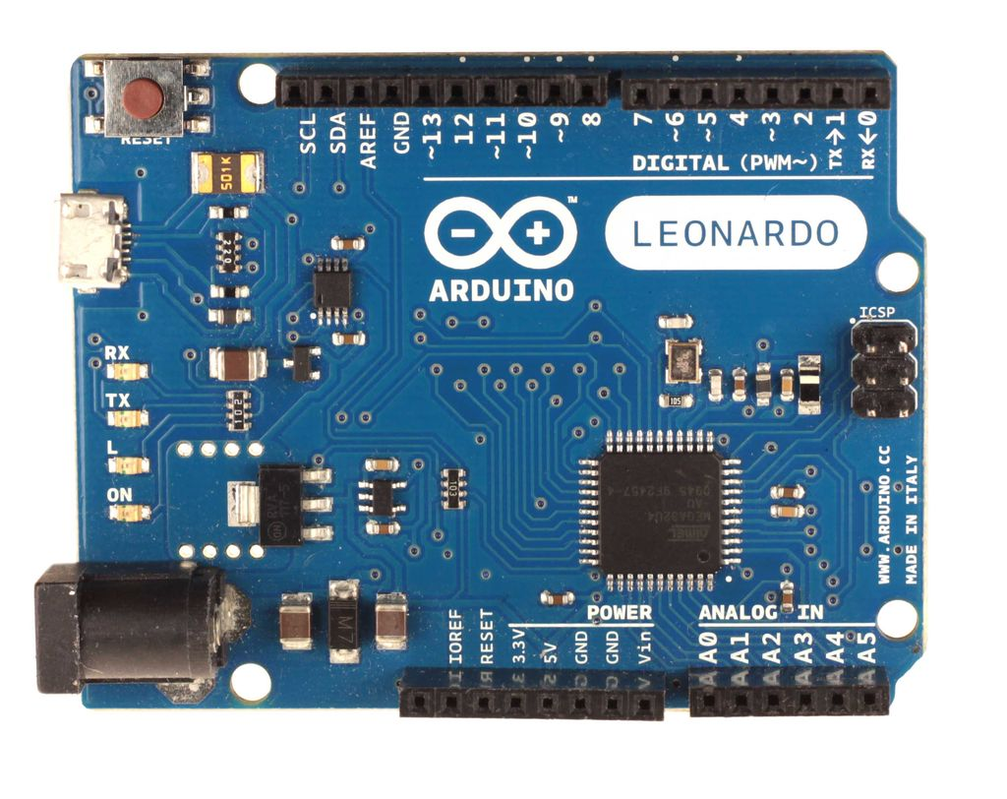
Arduino Leonardo:
Fig 6. Arduino Leonardo basic hardware

Slide 25
Some projects based on Arduino leonardo:
Humanoid Arm
Arduino PC Monitor
Autonomous Navigation and 2D Mapping
Arduino PowerPoint Pointer
Rangefinder for Garage Parking with Arduino

Slide 26
Arduino Shields:
Arduino shields are pre built circuit boards used to connect to a number of Arduino boards.
These shields fit on the top of the Arduino compatible boards
It provide an additional capabilities like connecting to the following:
Internet
Motor controlling
Providing wireless communication
LCD screen controlling

Slide 27
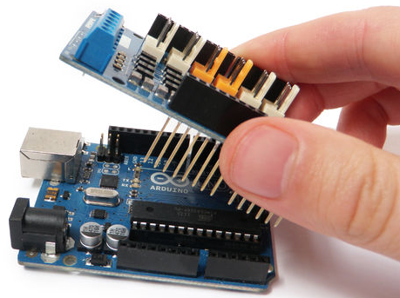
Arduino Shields:
Shields are useful to extend the capacity of your Arduino.

Slide 28
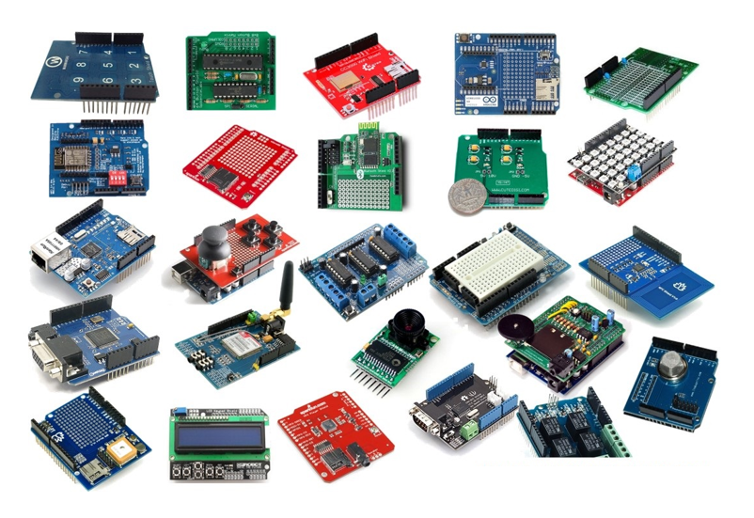
Different types of Shields:

Slide 29
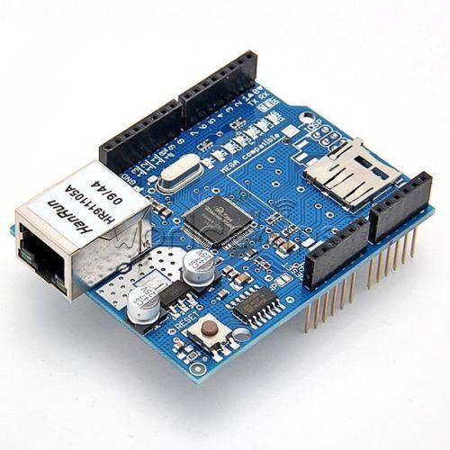
1. Ethernet Shield
The Ethernet Shield allows you to connect your Arduino to the internet. You just have to plug the shield onto the Arduino board and then, connect it to your network.

Slide 30
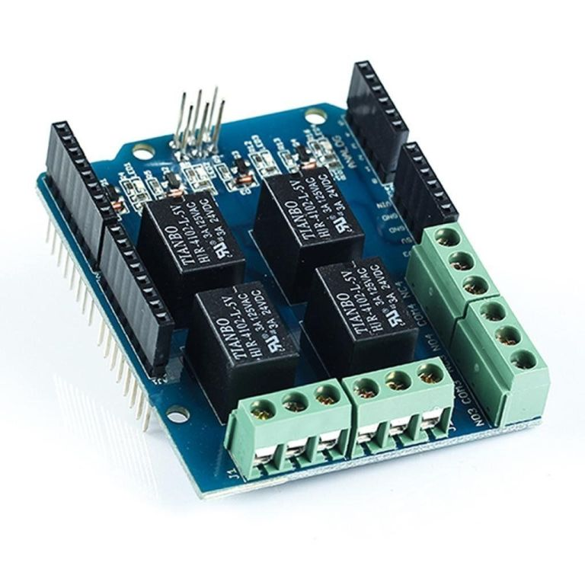
2. Relay Shield
The Relay Shield is a module with 4 mechanical relays that provides you an easy way to control high voltage.

Slide 31
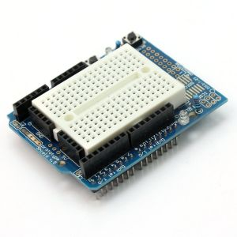
3. ProtoShield
The ProtoShield is a prototyping Shield that makes it easy to prototype. It allows for easy connections between the breadboard and the Arduino.

Slide 32
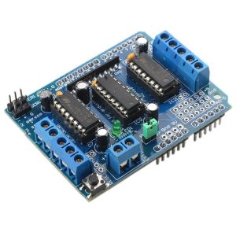
4. Motor Shield
This Shield allows an easy control of motor direction and speed. It makes it easy to incorporate a motor into any of your projects.

Slide 33
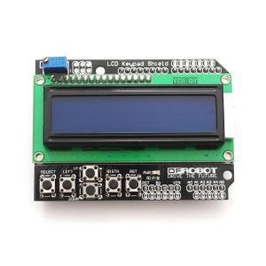
5. LCD Shield
This Shield makes it easy to use a 16×2 Character LCD. With this, it is possible to control a 16×2 Character LCD, up to 3 backlight pins and 5 keypad pins using only the two I2C pins on the Arduino.

Slide 34
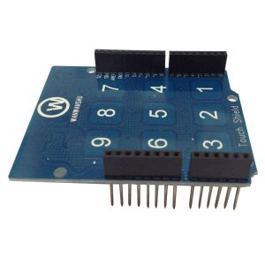
6. Capacitive Touchpad Shield
The Touchpad Shield allows you to build simple capacitive touch interfaces.

Slide 35
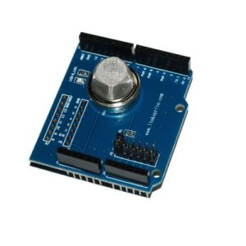
7. Smoke Detector Shield
This Shield can detect concentrations of combustible gas in the air and read it as an analogue value. Useful to make a smoke detector system.

Slide 36
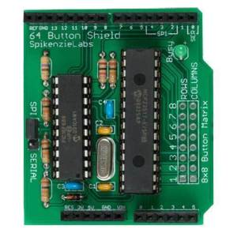
8. 64-Button Shield
With this Shield you can connect up to 64 buttons to your Arduino. Some cool projects with this shield include musical instruments, cool computer interfaces, etc.

Slide 37
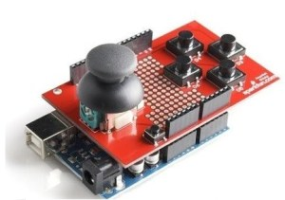
9. Joystick Shield Kit
The joystick Shield provides simple analog inputs and four separate buttons and one button under the joystick itself.

Slide 38
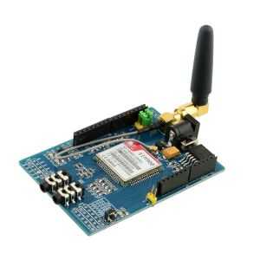
10. GSM/GPRS Shield
The GSM/GPRS Shield allows you to connect your Arduino to GSM/GPRS cell phone network. It allows you to dial a phone number or send a text message to a friend via easy to use AT commands.

Slide 39
11. GPS Logger Shield
12. Wireless SD Shield
13. cc300 Wi-Fi Shield
14. HC-05 Bluetooth Shield
15. MP3 Player Shield
You must know at least twenty-twenty five Arduino shields with it functionalities.

Slide 40
Thank you

